Slide 1




Enhancing Modality-Agnostic Representations via Meta-learning for Brain Tumor Segmentation
Aishik Konwer¹, Xiaoling Hu¹, Joseph Bae², Xuan Xu¹, Chao Chen², Prateek Prasanna²
¹Department of Computer Science, Stony Brook University
²Department of Biomedical Informatics, Stony Brook University
FRI-6th-2:30PM
Notes:
Hi everyone! This is Sounak Mondal from Stony Brook University. I am excited to talk about our model Gazeformer which offers scalable, effective and fast gaze prediction for visual search.

Slide 2
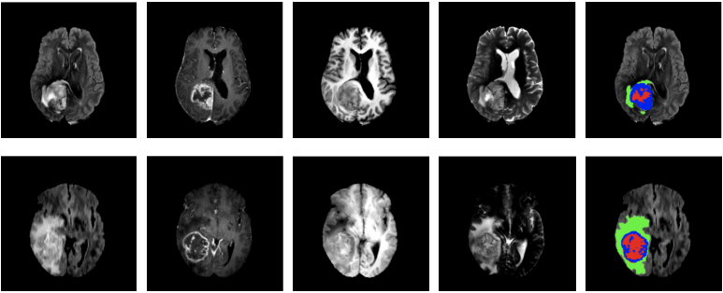
Clinical motivation
Accurate segmentation of brain tumors can expedite clinical procedures and aid treatment planning
Standard brain tumor segmentation^{1,2}
All 4 are needed
Only a subset of modalities may be available due to patient movements, erroneous settings etc
Existing segmentation models fail to handle missing modalities
Can we train a high-fidelity tumor segmentation model which is resilient to missing modality scenarios?
[1] Tang et. al, “Self-supervised pre-training of swin transformers for 3D medical image analysis”
[2] Wang et. al, “Multimodal brain tumor segmentation using transformer”

Slide 3
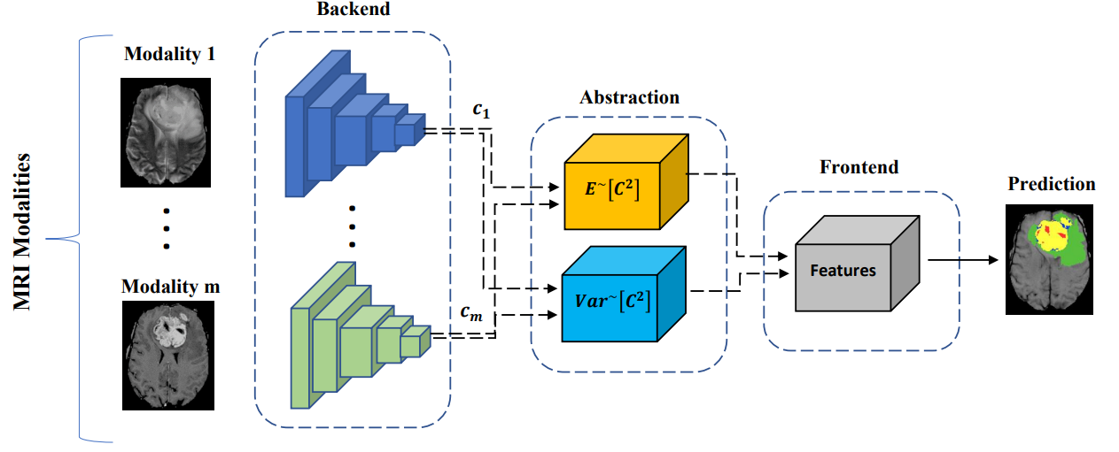
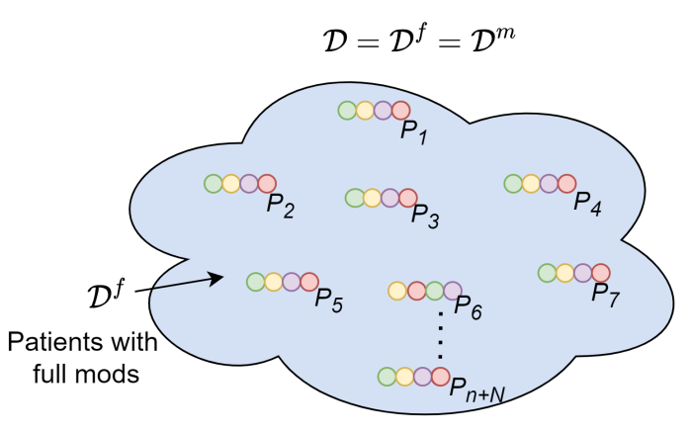
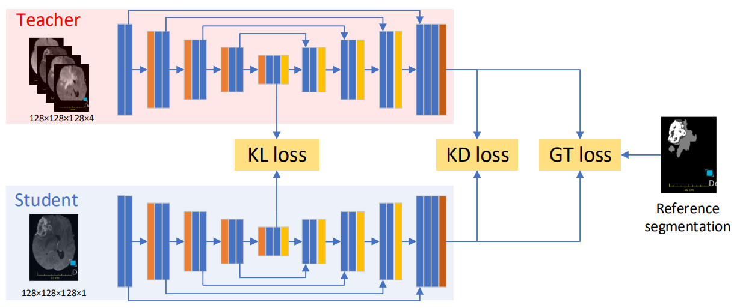
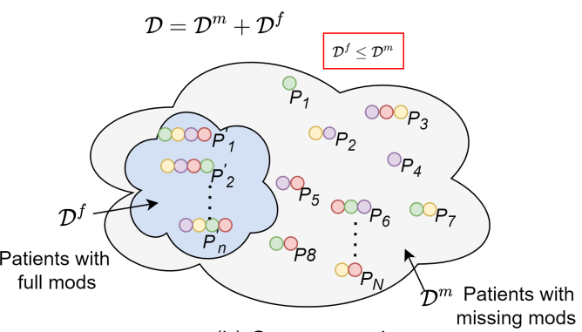
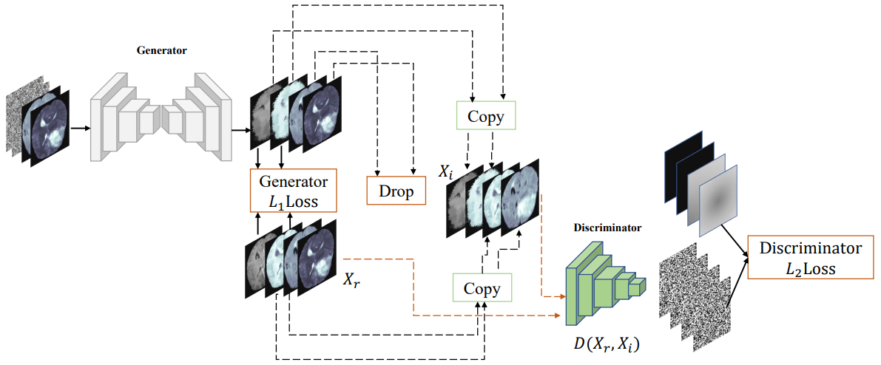
Technical challenges
The existing solutions to handle missing modality problem are:
Knowledge distillation – computationally intensive, full modality
GAN – non-converging nature and 3D image generation is unstable
Shared latent space – unable to recover lost information
Disadvantage: Most of these methods require access to full modality during training
HeMIS⁵
[3] Hu et. al, “Knowledge distillation from multi-modal to mono-modal segmentation networks”
[4] Sharma et. al, ”Missing MRI Pulse Sequence Synthesis using Multi-Modal Generative Adversarial Network”
[5] Havaei et. al, “”HeMIS: Hetero-Modal Image Segmentation”
KD-Net³
MM-GAN⁴

Slide 4
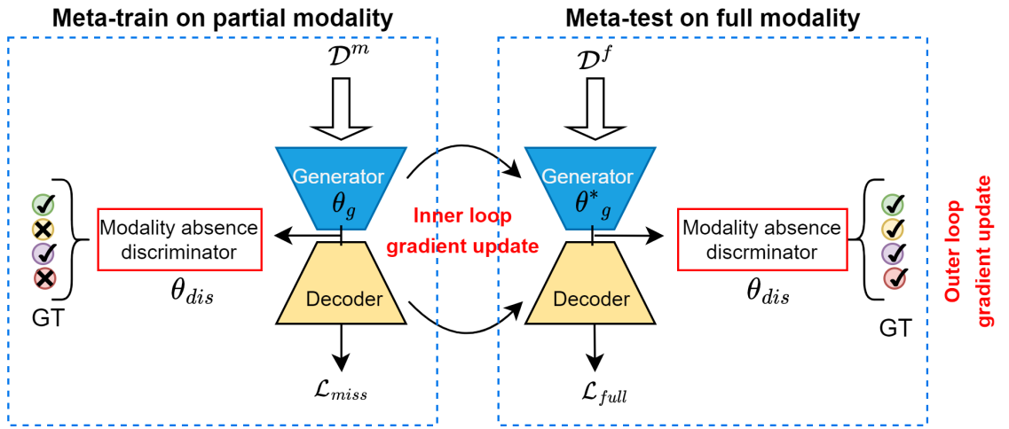
Contributions
Meta-learning
Limited full modality data (only during meta-test)
Mitigates the bias against rare modalities
Generalizability of model across tasks
Adversarial learning
Reconstruct the missing modalities in latent space
Enrich the partial modality representations

Slide 5
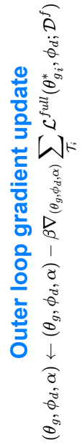
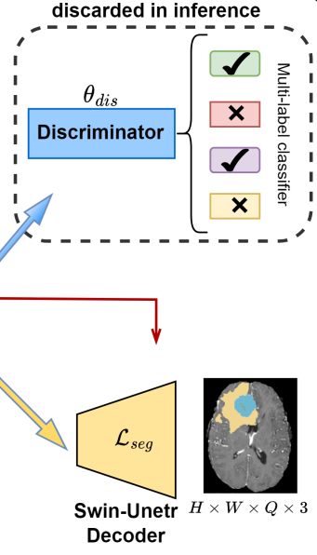
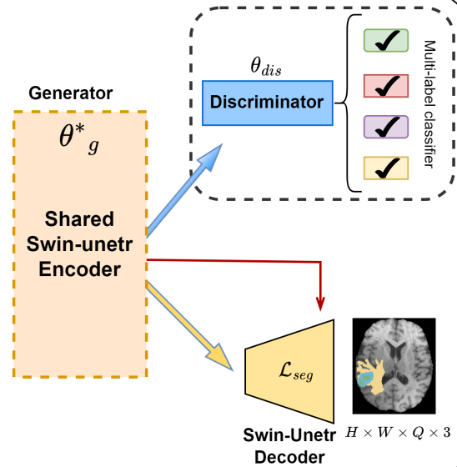
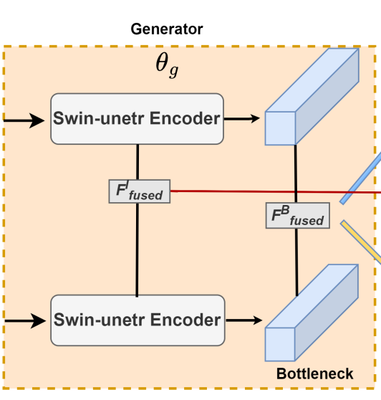
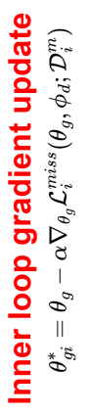
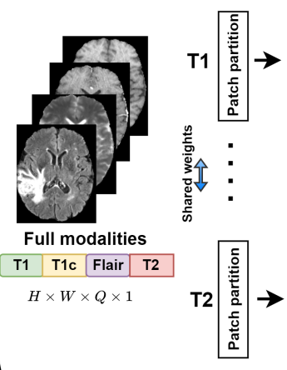
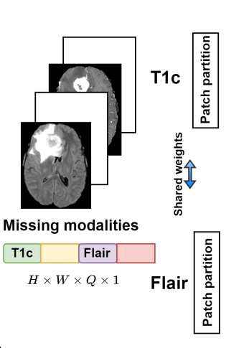
Framework
Meta-test
Meta-train
Meta-train
modalities dropped for heterogenous task distribution
swin transformers for feature extraction
improvised adversarial learning in latent space
segmentation
loss on partial modality data
Meta-test
full modalities
loss on full modality data

Slide 6
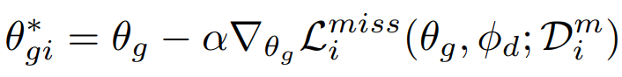
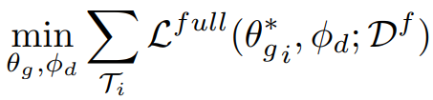
Feature adaptation
Obtain an optimal generator parameter θ_{g} through task-wise training on D^{m}_{i} by reducing the inner loop objective L^{miss}_{i}
Goal of the updated framework is to accomplish the outer loop objective L^{full} across all sampled tasks
All three meta parameters are meta-updated by averaging gradients of outer loop loss over a meta-batch of tasks

Slide 7
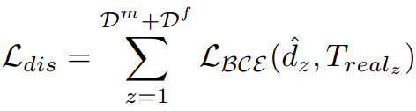
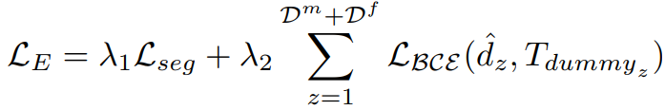
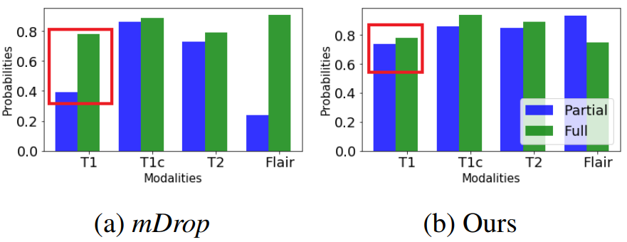
Feature enrichment
For discriminator loss, ground truth is real combination of modalities encountered at that iteration
For generator loss, ground truth is dummy variable set as {1,1,1,1} for M=4 modalities
Average probabilities obtained from our method attain comparable distributions across partial and full modality settings

Slide 8
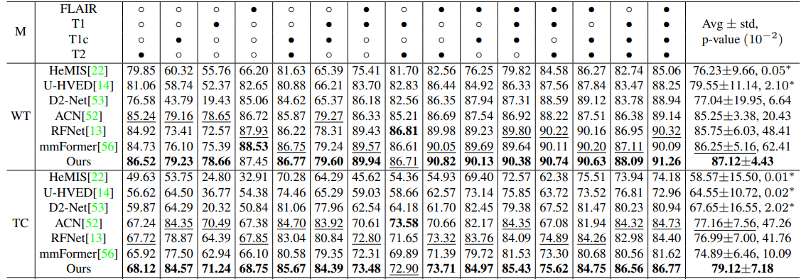
Quantitative results
Brats2018 (285 cases), Brats2019 (335 cases), Brats2019 (369 cases);
Metrics – DSC, HD95
Our method uses 50% FM samples and still:
outperforms SoTA by 11.78%, 12.93%, and 9.72% in DSC on the WT, TC, and ET regions for BRATS2018
beats non-KD models by a huge margin in severely missing situations

Slide 9
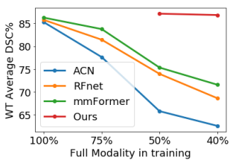
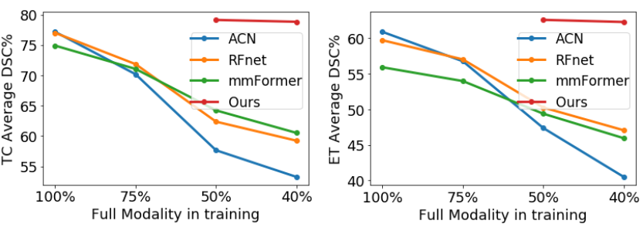
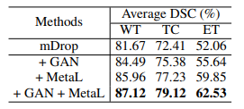
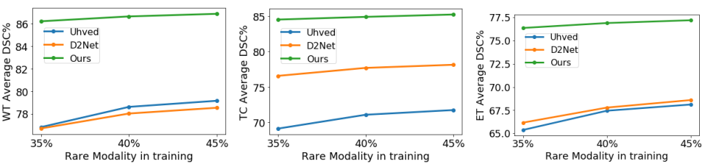
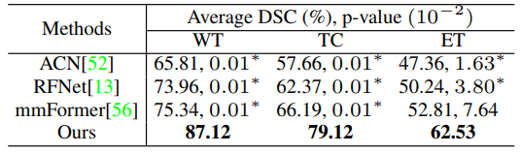
Ablation experiments
Effectiveness of major components
Robustness to proportion of full modality in training
Comparison with 50% full modality
Unbiased to presence of a rare modality (T1c)

Slide 10
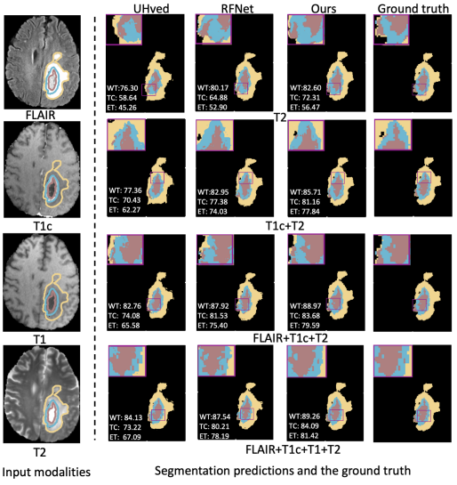
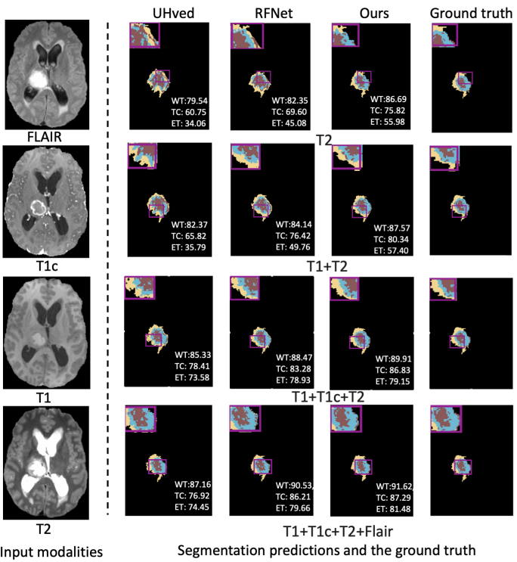
Segmentation maps

Slide 11
Conclusion
We present a novel training strategy to perform brain tumor segmentation under limited full modality supervision and with missing modalities
We adopt meta-learning to:
Mitigate the bias towards modalities rarely encountered in training
Use full modality data only in the meta-testing phase
We employ an improvised adversarial learning in latent space to generate superior modality-agnostic representations.

